Slide 1
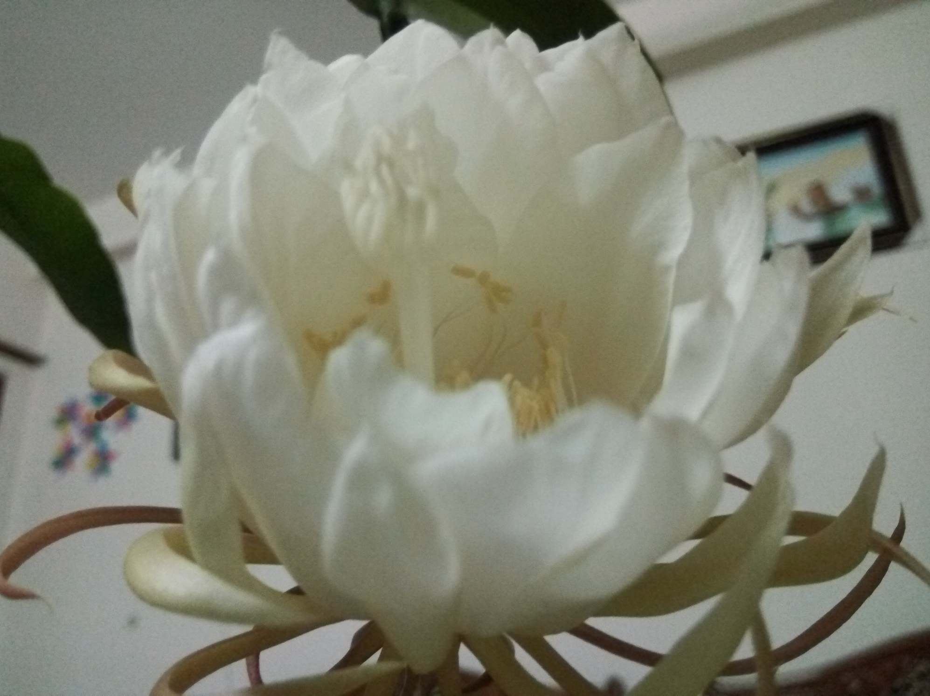

Welcome to the Introductory Class

Slide 2
One Question for You!
Why are you in here?

Slide 3
Education means???

Slide 4
Etymological Meaning of Education-1
In English the term “Education” has been derived from two Latin words Educare (Educere) and Educatum. “Educare” means to train or mould. It again means to bring up or to lead out or to draw out, propulsion from inward to outward. The term “Educatum” denotes the act of teaching. It throws light on the principles and practice of teaching.

Slide 5
Etymological Meaning of Education-2
In narrow sense, Education is a process in which and by which knowledge, character and behavior of the young are shaped and moulded (Drever). Education is conscious effort to develop and cultivate our innate powers (Mackenzie).The influence of the environment of the individual with a view to producing a permanent change in his habits of behavior, or thought and attitude (Thompso).

Slide 6
Etymological Meaning of Education-3
In the wider sense, education is that process by which an individual freely develops his self according to his nature in a free and uncontrolled environment. It is a process that goes on throughout life, and is promoted by almost every experience in life (Mackenzie). By education, I mean the all-round drawing out of the best in child and man’s body, mind and soul (Gandhi).

Slide 7
Means of Education
According to Rabindranath Tagore the aim of education is self-realization. The means of education is to understand the purpose of our life – the purpose of individual existence. Understand what it is towards which you are thriving. Then utilize every emotion, every thought to strengthen you. The highest function of education is to bring about an integrated individual who is capable of dealing with life as a whole. Education means a transformation of human mind and creation of new culture (Krishnamurti, 1973). According to Socrates, education means the bringing out of the ideas of universal validity which are latent in the mind of every man.

Slide 8

Introduction to Course
Md. Fouad Hossain Sarker
Assistant Professor and Head
Department of Development Studies
Daffodil International University (DIU)

Slide 9
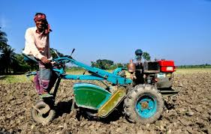
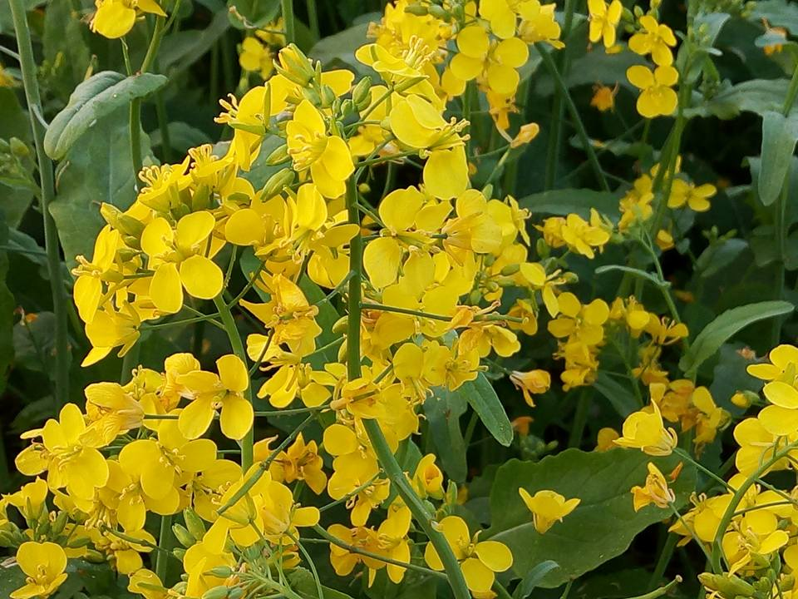
Unlock Your Potentiality!!

Slide 10
Can you define your role??

Slide 11
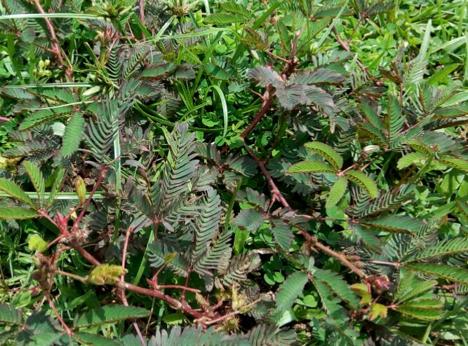
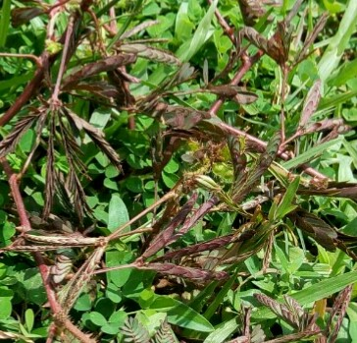
Your Role !!!

Slide 12

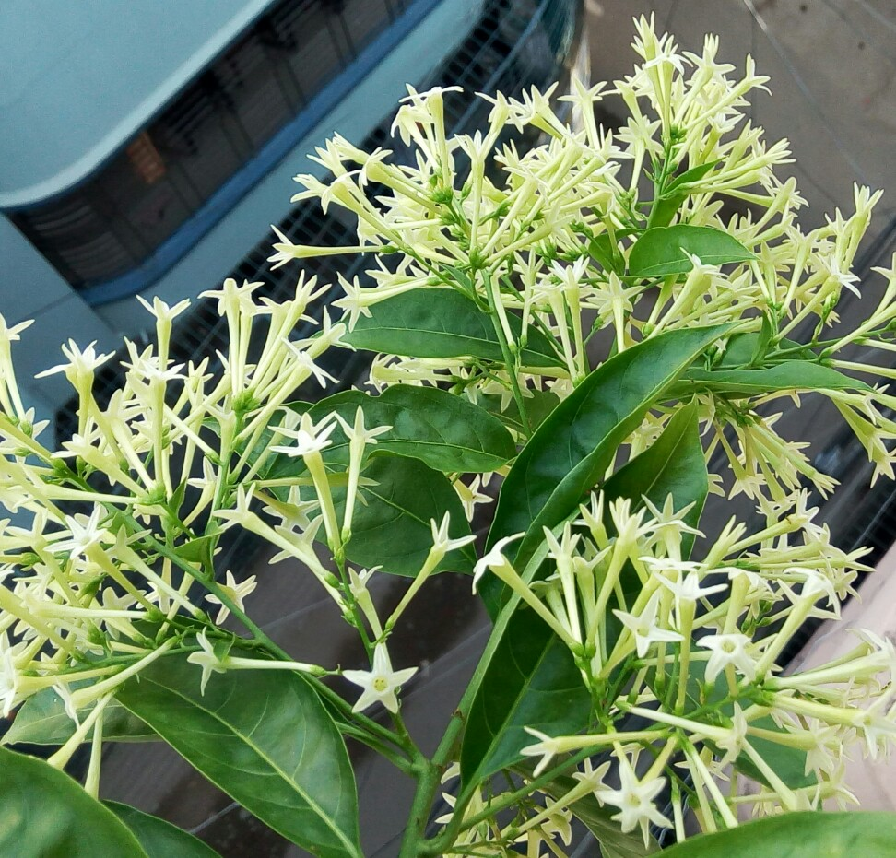
Reveal Yourself !!!!

Slide 13
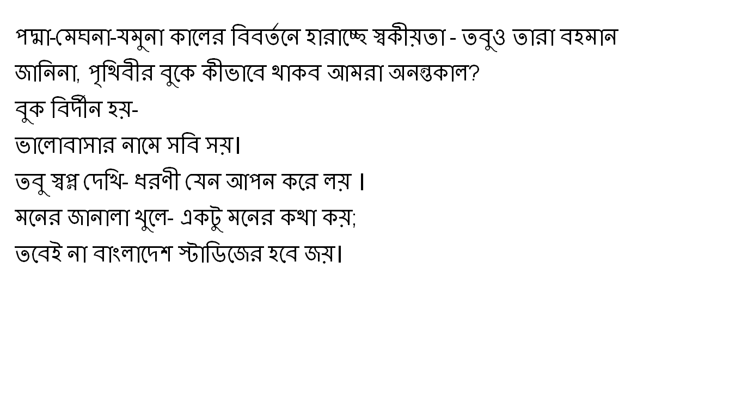
Insight Values

Slide 14
Can you mention the
objectives of this session??

Slide 15
Objectives of this class
Explore the objectives of this course
Investigate the key issues of course outline
Demonstrate the course approach
Illustrate the way of teaching and learning
Analyze the rules and regulations

Slide 16
Objectives of this class
Identify some references for readings
Understand the students background and
Motivate them for future development
Signify the lecture areas and outcomes of this course

Slide 17
Student’s Observation
Mostak Ahmad 142-15-3800, Aug 8, 2015 (CSE)
First day of the 4th semester. I'm walking along the Dhanmondi 27 road. Usually, I should have a cheerful mind as after a long vacation of the semester break, I was going to meet with my beloved friends. But I didn't do so & the reason was something had been happened wrongly & this was I enrolled myself in the B section. Not because of I enrolled myself in the B section, actually, my mind was full of sorrows since in that section the Bangladesh Studies course would be taken by a Royal Bengal Tiger whose name Fouad Sarker or something else. I didn't know him but the senior brothers informed us that he is not less than as ferocious as a Royal Bengal Tiger.

Slide 18
Student’s Observation (Cont.)
The only difference between Fouad sir and Tiger uncle is, the Tiger uncle lives in the forest where Fouad sir at Daffodil varsity. After hearing this we got feared & we begged suggestion from them how we would be escaped. The senior brother's the only and the just only suggestion was not to be enrolled in the Fouad sir section. I was late as I had already enrolled myself in that section. My fearness grew little more when I had come to know to that lots of students left the section. However, nothing was to do then. I accepted my lot being compelled. I entered the class & did the whole class.

Slide 19
Student’s Observation (Cont.)
U may never believe what was my mind condition after the class. What I heard & what I had just enjoyed. What a fantastic teacher he is! What a wonderful skill to take a class he possesses! I really surprised. I have never seen such kind of ideal teacher in my life before. From the first class , he went to my heart. Nothing is constant in the earth. Beginning is the pre-alarm of the ending. In this flow today I'm going to attend to my last class of Bangladesh Studies. Same to the first class, I'm walking along the Dhanmondi 27 road.

Slide 20
Student’s Observation (Cont.)
But today I'm really feeling lucky to have such kind of teacher ' Fouad Sarker '. In my life I never forget him. He is not only a good teacher, his teaching technique is not only awesome , rather his attitude , his punctuality, his manner , specially his smile attract me most. I not only learn about my course from him , but learn how to possess a good personality , how to be a good human being.
At the last, I can proudly say that Bangladesh Studies teach me more than the course. I will really miss Bangladesh Studies... I will really miss Fouad Sir....

Slide 21
Why do you need to carry on your journey with this course??

Slide 22
Objectives of this Course
To equip students with the knowledge about focal themes relating to Bangladesh. The first theme is the inevitability of the emergence of Bangladesh as a state entity in the context of a long historical background and the second themes draw attention to the experience of Bangladesh as a rising state in the Third World in governance and democratization.
The students attending this course are expected to be made aware of the past and present of Bangladesh for the enlargement of their knowledge to face 21st century.

Slide 23

Insight Objective
What do you understand from the above picture?

Slide 24

Your Answer!
A
little
drop
of
water
makes
a
mighty
ocean.
A little drop of water makes a mighty ocean.

Slide 25
Introduction to Lecture Plans
Lecture:1 Introduction to Course
Lecture: 2-3 Bangladesh: Geography, Demography & Cultural Traits
Lecture: 4-5 Origin of the name of Bangladesh, Bangla Language & People of Bangladesh
Lecture: 6-7 Foreign Affairs in Bangladesh
Lecture: 8-9 Constitution of Bangladesh
Lecture: 10 CT-1& 2

Slide 26
Introduction to Lecture Plans (Cont.)
Lecture: 11-13 Background of Bangladesh (Language movement, Discrimination against East Pakistan, Six-points program and Liberation War of Bangladesh)
Lecture: 14-15 Economy of Bangladesh
Lecture: 16-17 Environmental degradations & Climate Change:
Bangladesh perspective
Lecture: 18-19 Industrial Sectors of Bangladesh
Lecture: 20 Class test 3 & 4 and Revise whole syllabus

Slide 27
Course Approach
The approach of this course highly imparts the neutral or rational tone to streamline the goal and ensure minimal academic jargon. Moreover, this course avoids all sorts of non-judgmental manners that impede to understand the insight values and facts of Bangladesh.

Slide 28
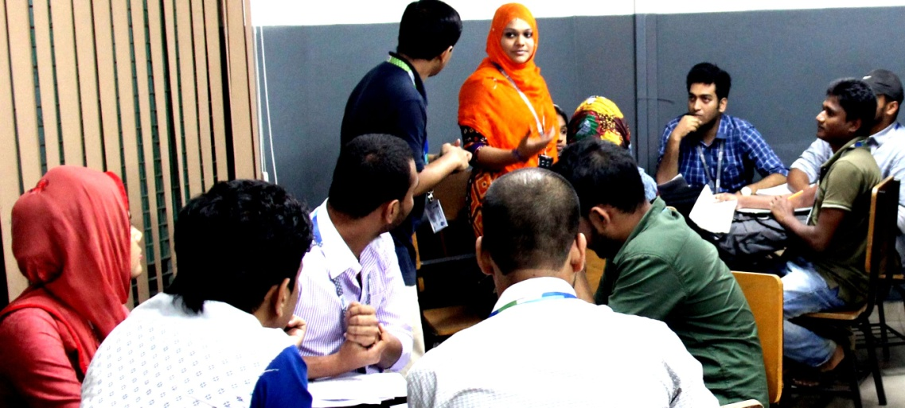
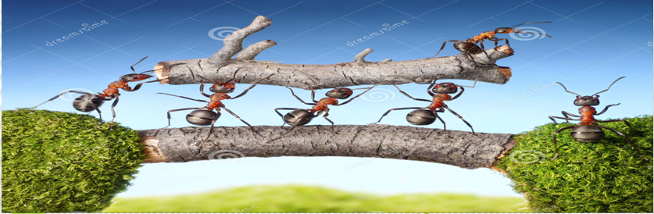
Methods of Teaching & Learning
Teaching will cover the areas of lectures, power point presentations, participative discussions and problem solving. Students are highly encouraged to participate in discussion and problem solving sessions. Active participation in the class will carry credit. On the other hand, Group study/Team work/Peer study method will be followed for better understanding.

Slide 29
Rules and Regulations
Students must wear DIU ID for entering the classroom
Active participation in online platform ( Google classroom)
50% Class attendance is mandatory for taking part of any exam of Bangladesh Studies
For any kind of exam, university rules and regulations will be followed very strictly
Students must keep silence their mobile phone during the class session

Slide 30
Rules and Regulations
Active participation will be considered for bonus marks
No dress code but have to ensure decency
Neat and Clean……………
Not practice any irrational culture e.g. to count best two CT exams
If anyone miss any CT Exam, submission their assignment/ presentation in time, never give them any opportunity for future

Slide 31
Marks Distribution
SL.NO. | Distribution Area | Percentage of the marks
1 | Class Attendance | 07
2 | Quiz/ Class Test | 15 (4 Class tests# 2 online/2 face to face class
3 | Presentation | 08 (2+3+3)
4 | Assignment | 05 (2+3)
5 | Semester Final | 50

Slide 32
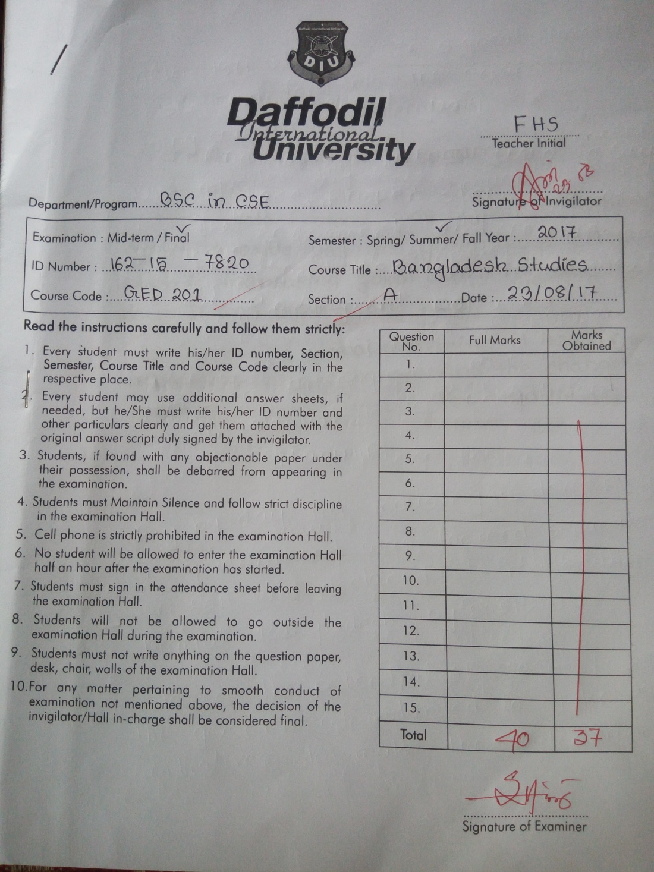
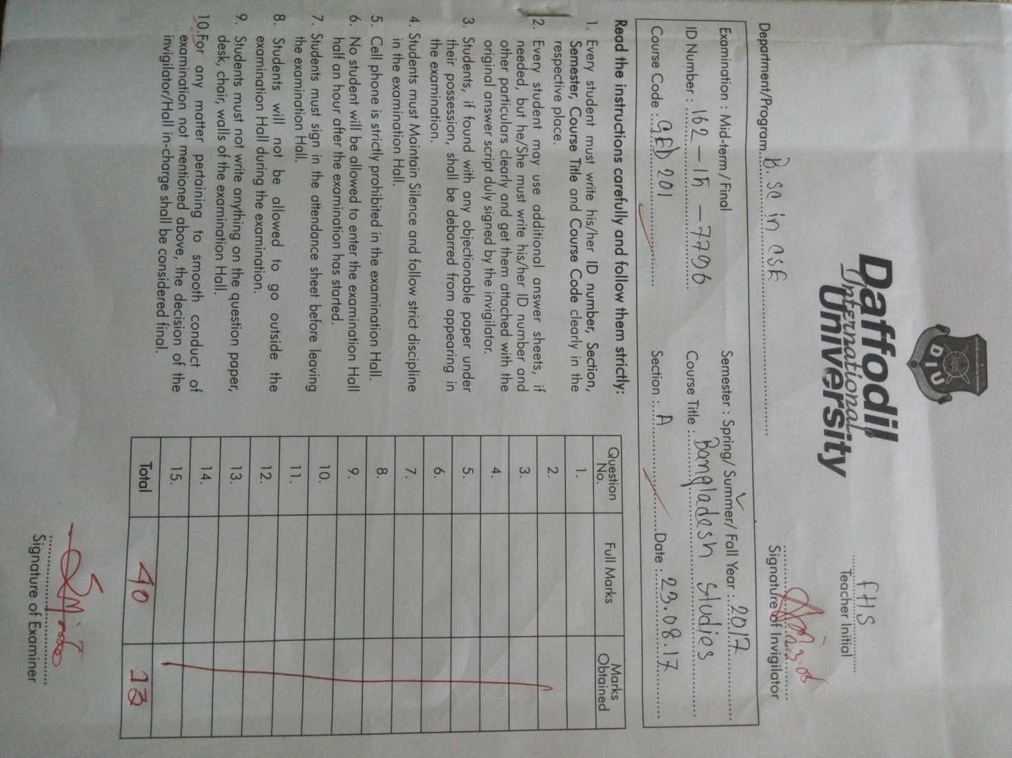
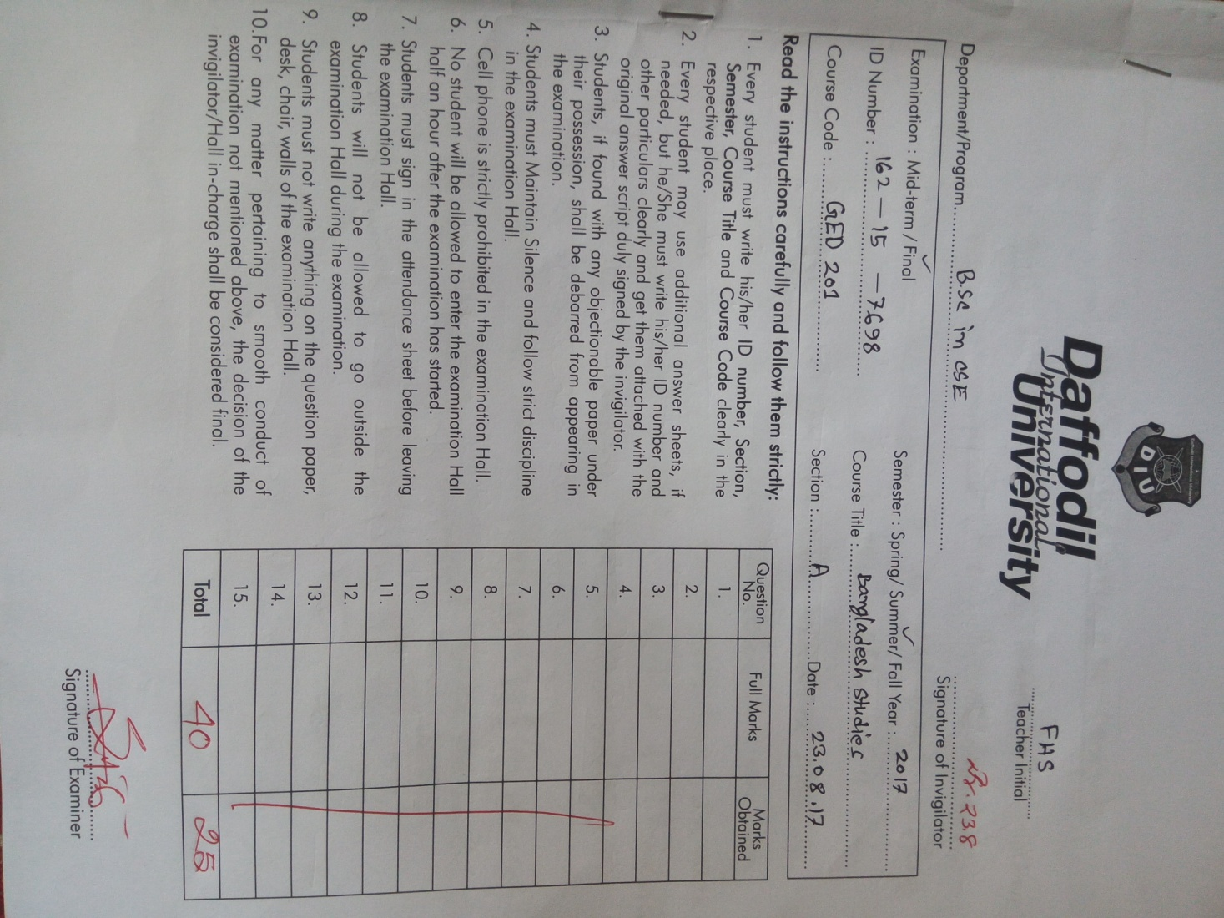
Answer Scripts !!

Slide 33
Reference Books
Ausamapta Atmajiboni (Unfinished Memories), Sheikh Mujibur Rahman, The University Press Limited, 2012.
Bangladesh Revised -A Comprehensive Study of an Asian Nation, Muhamad Ruhul Amin, OSDER Publications; October-2010.
Banglapeadia, National Encyclopedia of Bangladesh. Volume-1 to 10, Asiatic Society of Bangladesh, March, 2003.
History of Bangladesh (1704-1947), edited by- Sirajul Islam, Asiatic Society of Bangladesh, and Vol-1 & 3, 1992.
Constitution, Constitutional Law and Politics: Bangladesh Perspectives, Md. Abul Halim, Rico Printers, Dhaka, 2003.

Slide 34
Reference Books (Cont.)
Bangladesh Studies: Politics, Administration, Rural Development and Foreign Policy, Edited by- Mohammad Mohabbat Khan & Syed Anwar Husain, Center for Administrative Studies, 1985.
Bangladesh, On the Threshold of the Twenty-first Century; Edited by-A.M. Chowdhury & Fakrul Alam, Asiatic Society of Bangladesh, 2002.
Socio-Economic Condition in Bangladesh, Chowdhury Tamzid Ahmed, Tapan Prakashon, Dhaka.
The Politics of Nationalism: The Case of the CHT, Bangladesh, Amena Mohsin, University Press Limited, Dhaka, 1997.

Slide 35
Reference Books (Cont.)
Bangladesher Itihash, Dr. M. Abdur Rahim, Dr. Abdul Momin Chowdhury, Dr. A.B.M. Mahmood and Dr. Sirajul Islam, Nawroze Kitabistan, Dhaka-1000.
Bangladesh Economic Review Report, Ministry of Finance, Government of Bangladesh.
Kapur, A. C. (2009). Principles of Political Sciences, Chand Publisher.
Jahan, R. (ed), (1994). Bangladesh Politics: Problems and Issues, University Press Limited, Dhaka.

Slide 36
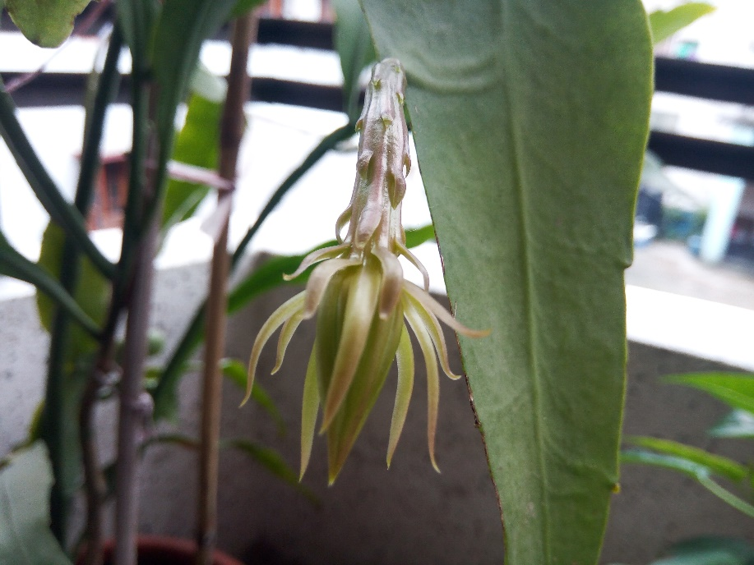
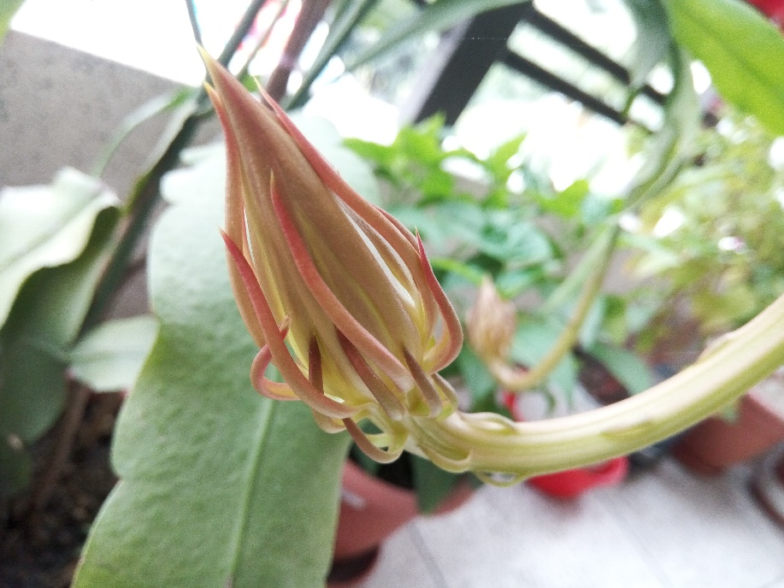

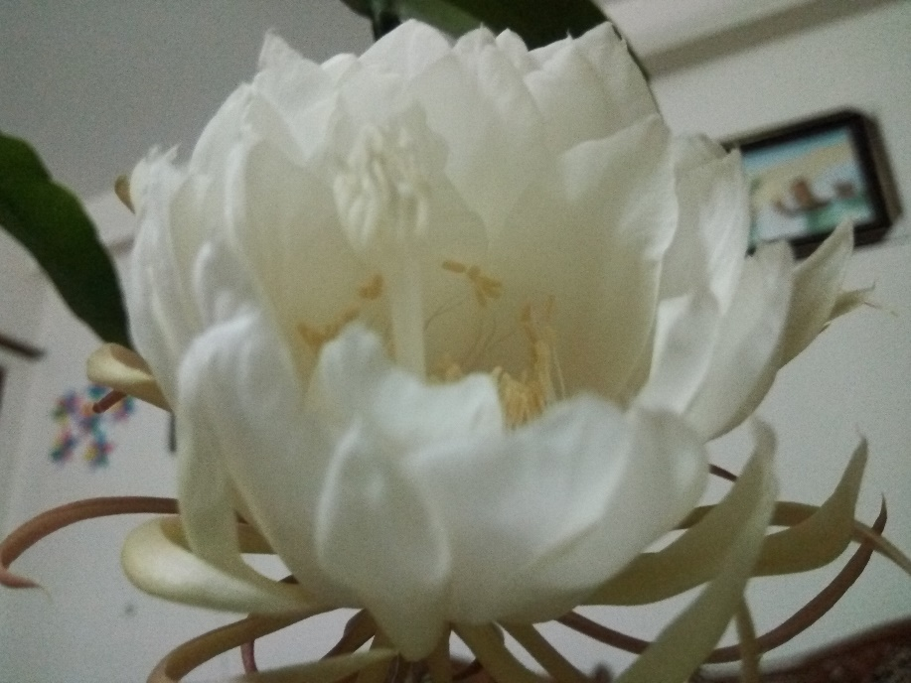
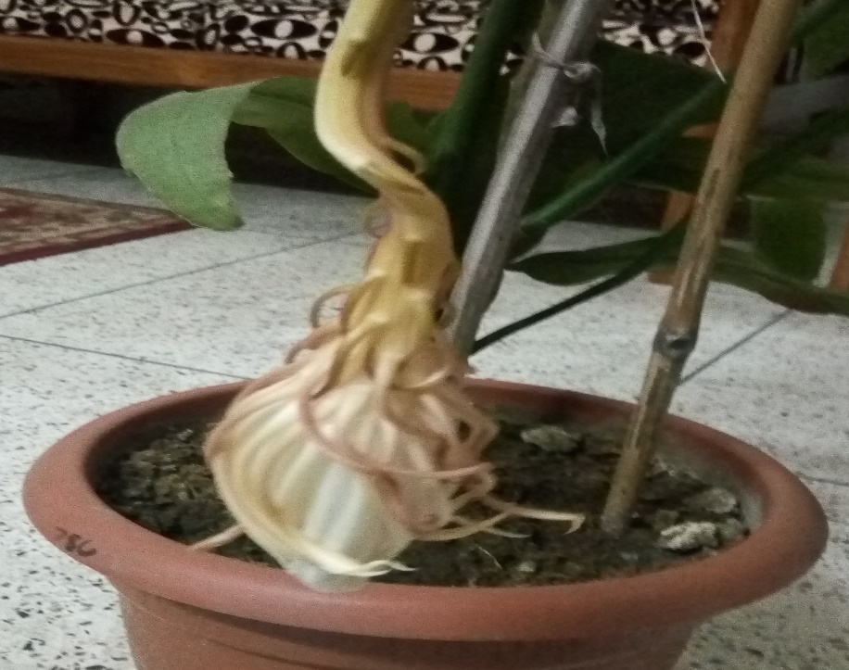
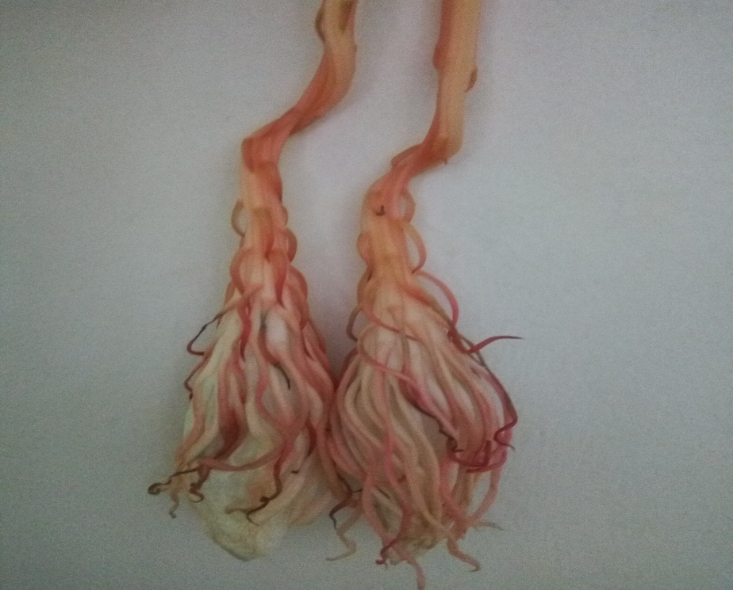
Role of Nature!!!

Slide 37
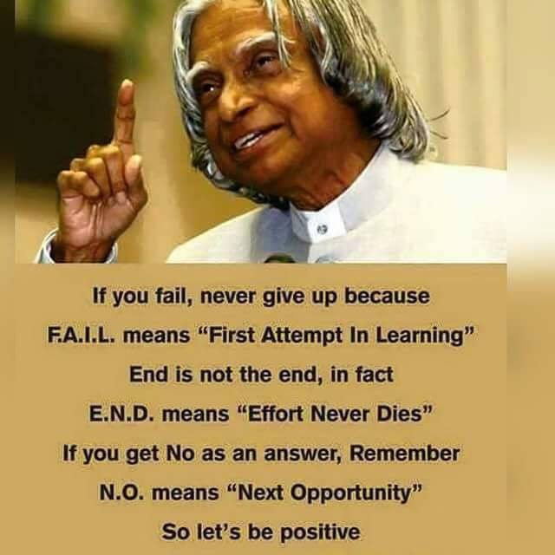
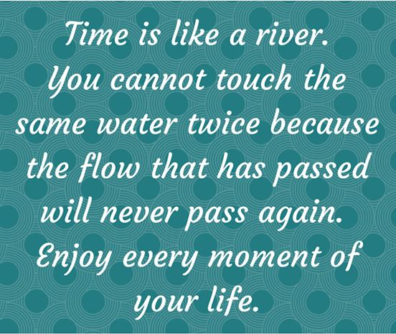
Be Positive

Slide 38
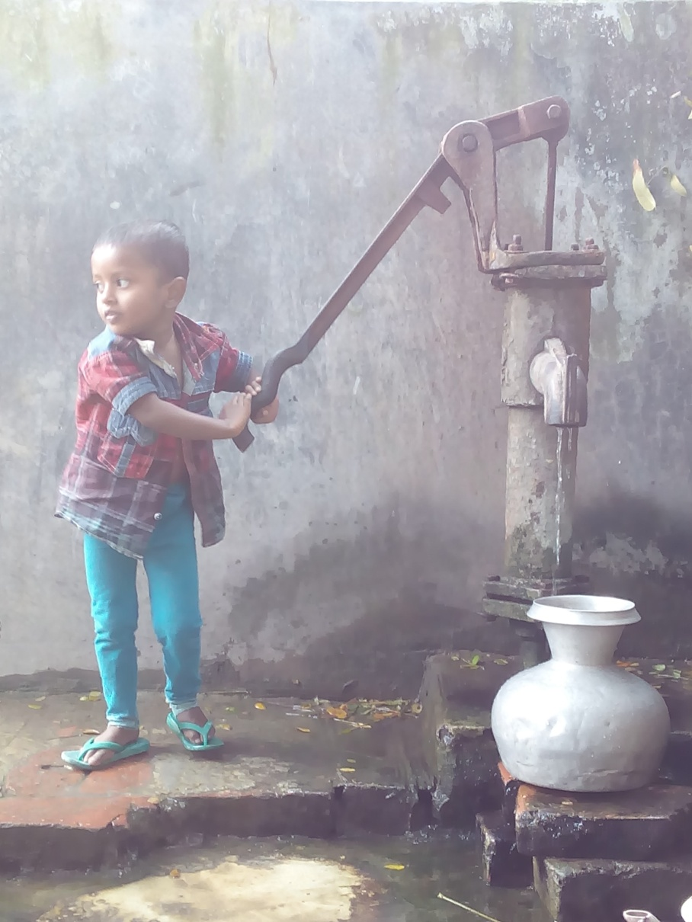
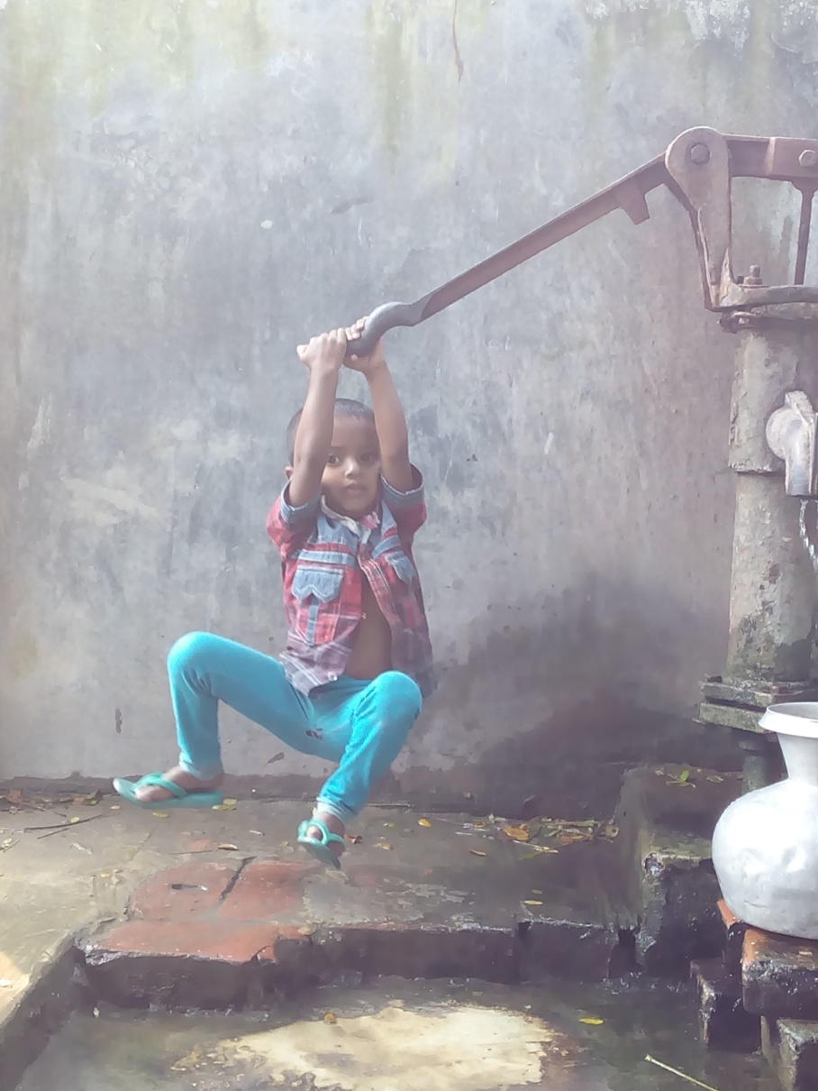
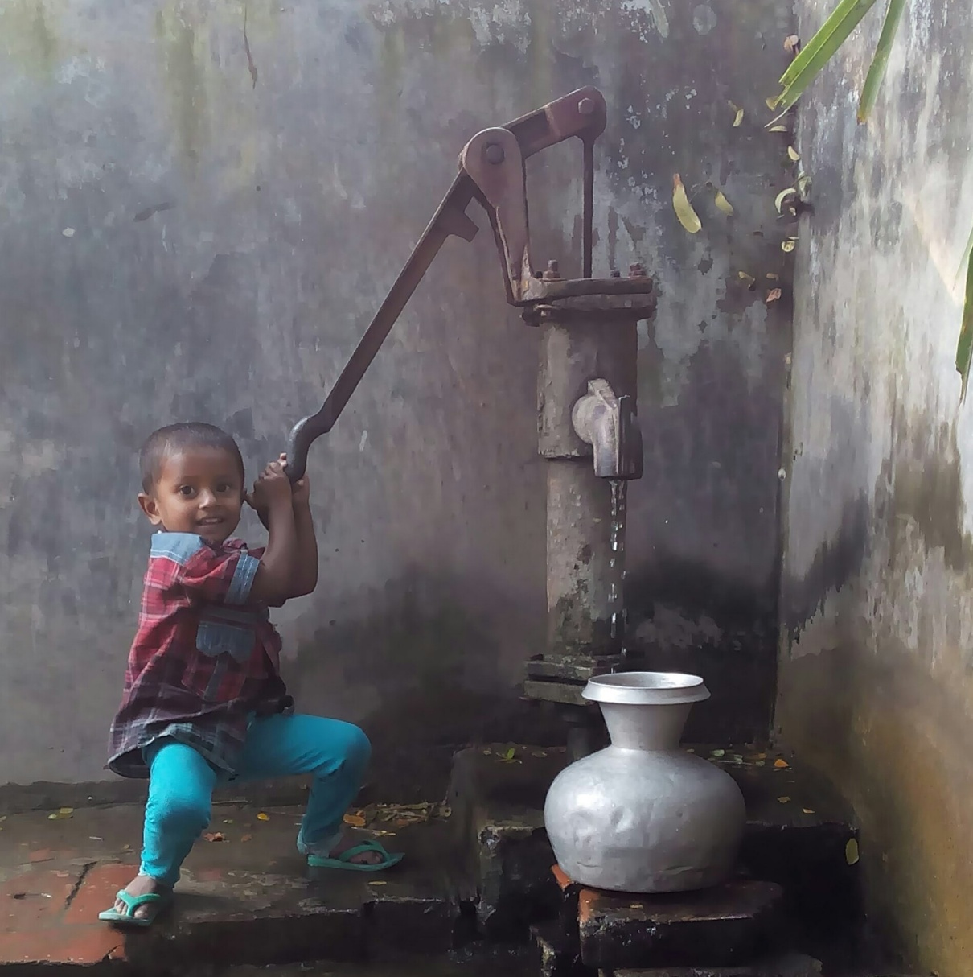
Come out of the Box

Slide 39

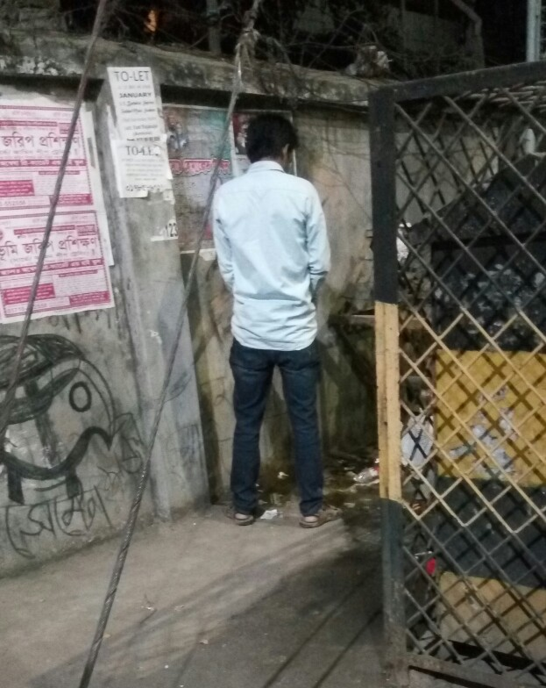
Can we change to make a better world?

Slide 40
Approaching for Future Development
How to develop yourself? Your Commitment/passionate
Area of Development: Knowledge of English, IT, Smartness, and be Communicative
Never demean yourself, Philosophy: just make or mar
We have to love ourselves with all our heart and with all our soul and with all our mind and with all our strength.

Slide 41
Career Development Discourse
Avoiding most common mistakes in English
Use of capital letter
Use of auxiliary verb
Use of s/es
Use of article
Use of many/much/some /amount/number etc.
Spelling and finally
Organization of a sentence

Slide 42

Please listen the song- Manush Manusher Jonne

Slide 43
Please listen the song – Ami Shunechi Shedin Tumi

Slide 44
Experience Sharing
Case Study-1: Sharukh Khan (False Statement)
Case Study-2: Jannat (False Statement)
Case Study-3: Obayat (False Statement)
Case Study-4: Ratan Bissash (False Statement)
Case Study-5: Farhad ( Drug Addicted)
Case Study-6: Assadullah Galib ( Removing inertia)

Slide 45

Outcomes of this Course

Slide 46
Feedback
Q1: What do you think about our today’s class?
Q2: Can you assess this class? Is it participatory oriented?
Q3: Give your suggestions for making classroom very active.
Please answer through: gg.gg/fhsfeedback
Thank you all with the journey of Bangladesh Studies

Slide 47

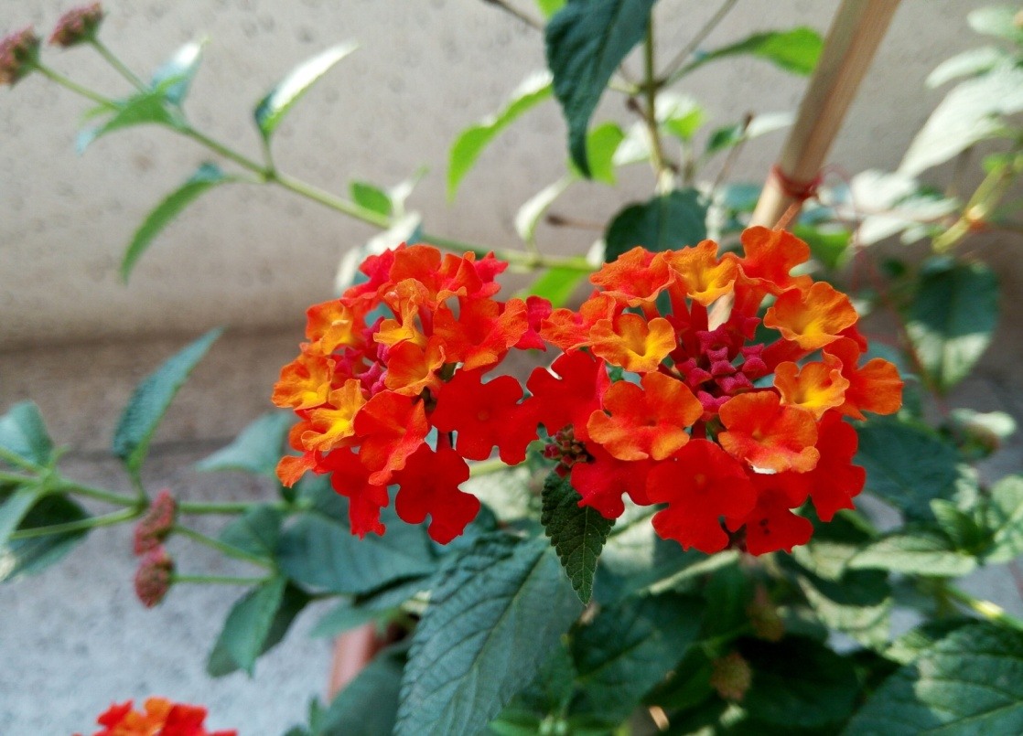
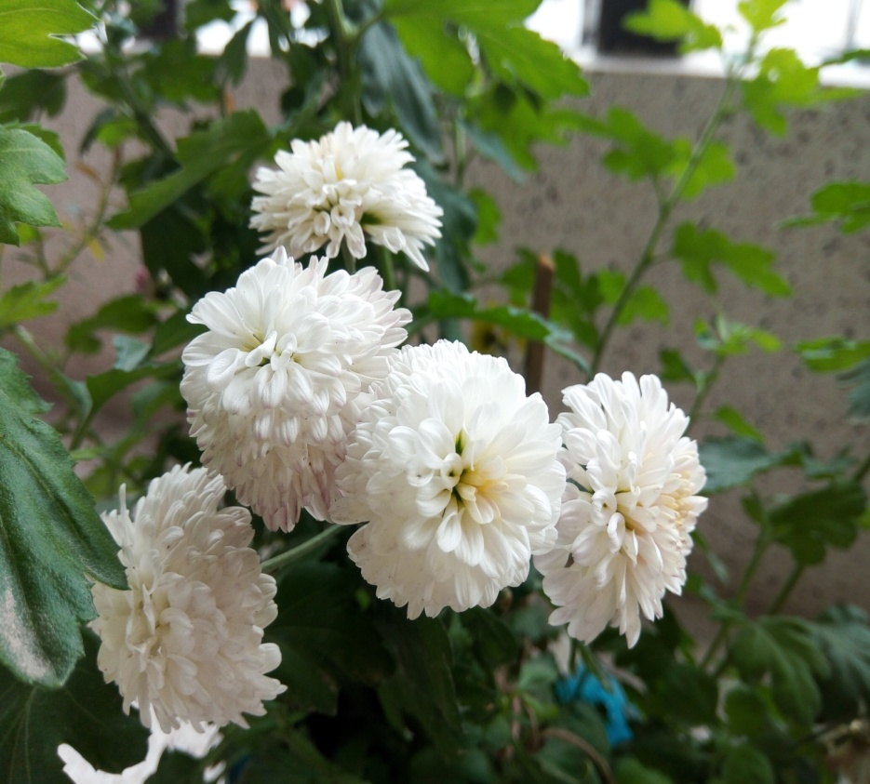
Commitment for Future
Change we believe in together

